Slide 1

Weekly Report
Tianyu Wang
September 8,2021

Slide 2
Review of Last Meeting
Completed:
Do topic modeling with LDA
To do:
Do topic modeling with Twitter-LDA

Slide 3

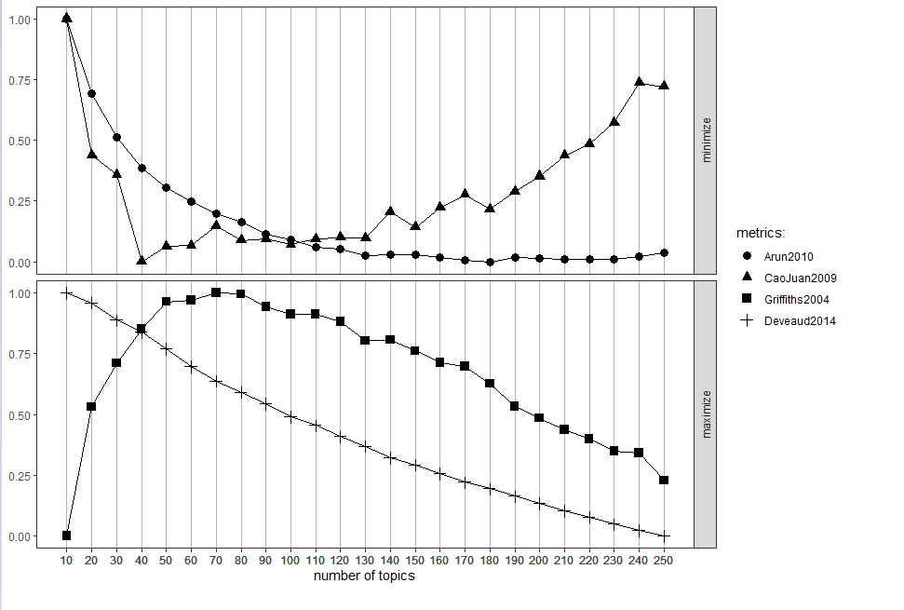
Topic words for commit message
topics: 40
alpha_g: 1.5
beta_word: 0.65
beta_b: 0.0001
gamma: 50
iteration: 200
appear twice: 57
appear three times :12
appear four times : 1

Slide 4
Background words for commit message
implement 0.007991922
data 0.0069041746
index 0.0068286364
time 0.006647345
apr 0.0061336868
create 0.0058919652
server 0.0056502437
start 0.00548406
map 0.005453845
improve 0.0053631994
version 0.0053631994
message 0.0052574463
list 0.005076155
method 0.0049855094
case 0.004955294
default 0.004879756
commit 0.004834433
error 0.0047891103
log 0.004743788
add 0.0904492
fix 0.074676864
test 0.04911481
remove 0.022948446
change 0.022555647
update 0.019126223
support 0.018975148
code 0.014442868
make 0.011859467
file 0.011647961
class 0.011451563
bug 0.010363815
move 0.010212739
work 0.0095933275
set 0.008958808
check 0.008701979
handle 0.008596226
issue 0.008475365
type 0.00832429

Slide 5
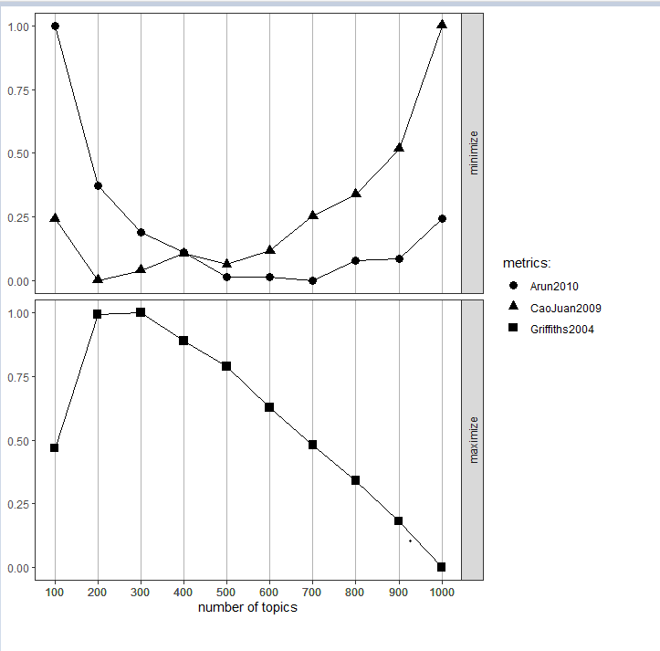
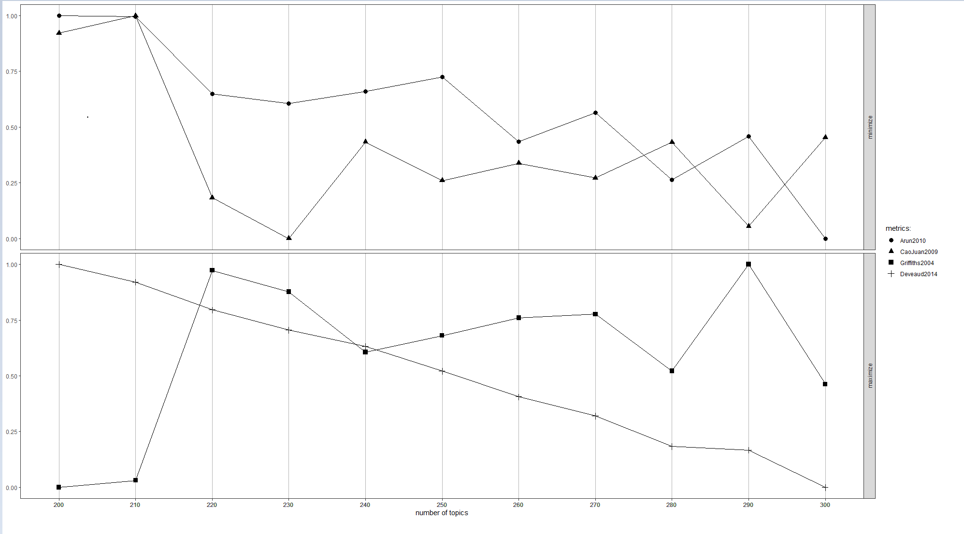
Topic words for code comment
topics: 230
alpha_g: 30
beta_word: 50
beta_b: 0.001
gamma: 20
iteration: 10
appear twice: 371
appear three times :153
appear four times : 96
appear more than four times:983

Slide 6
Background words for code comment
find 0.032614056
observable 0.01835616
source 0.017108299
constant 0.015246524
null 0.013070132
data 0.012519848
check 0.012105073
result 0.011613705
shape 0.01146877
type 0.010458934
set 0.010359953
array 0.009261742
method 0.0086266175
index 0.008565344
throw 0.008089295
exception 0.0076627363
time 0.0075437245
give 0.0074211773
start 0.007170191
item 0.006766021
row 0.0065822
function 0.0062558004
agent 0.00621338
add 0.0058551654
end 0.0057927133
order 0.0052848496
return 0.00498673
dimension 0.00473103
number 0.0047204252
thread 0.004608483
test 0.0045578144
write 0.0043728156
list 0.0043209684
create 0.004295045
indent 0.004276192
request 0.0042149182
default 0.004201956
make 0.0040911925

Slide 7
Next Step
1. Summarize the topic.

